Slide 1


July 18th, 2024
Diego Mandelli
RAVEN, SR²ML, and LOGOS
Safety, Risk, and Reliability Applications

Slide 2

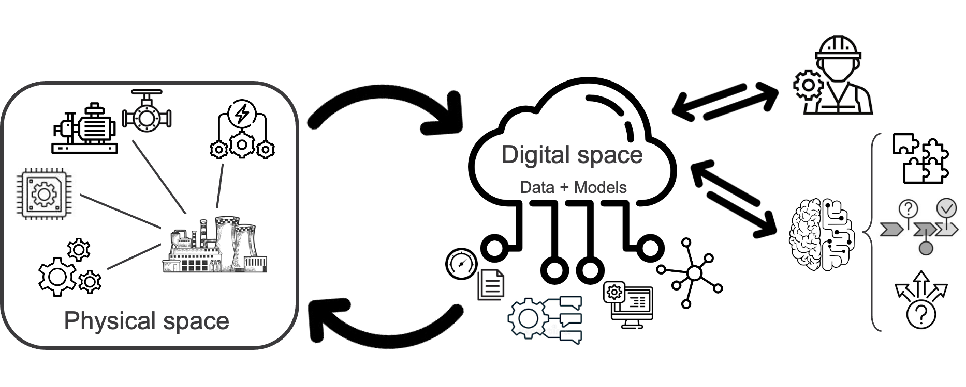
Plant Operations
Focus of this talk: Support plant operations by creating a direct link between data and decisions through data analytics methods
From periodic to predictive operations
Towards Industry 4.0
Ageing, degradation, maintenance
Failure mode
Form
Function
Surveillance
Focus of reliability
Predictive operations (Industry 4.0)
Data
Decisions

Slide 3
RAVEN
Modeling capabilities
Interface to many codes, e.g., RELAP5-3D, SAPHIRE
Linking models together, e.g., ensemble model, logical model
Goal: create data-driven workflows among models
Surrogate modeling
Method capabilities
Uncertainty quantification
Standard optimization
Genetic algorithms
Multi-objective optimization
Pareto frontier analysis
Multi-objective genetic algorithms
Decision making performed over multiple figure of merits: costs, reliability, availability, resilience

Slide 4
LOGOS and SR²ML
LOGOS: Provides plant resources optimization tools
Integration of multiple figure of merits
e.g., risk and costs
Asset management
Job scheduling
Flavors
Deterministic
Stochastic
Distributionally robust
Risk-based
SR²ML: Provides system reliability modeling tools
Modeling capabilities
Analysis of equipment reliability data
Reliability models which integrate: ageing, maintenance, and surveillance
Method capabilities
Margin-based reliability analysis
Models for simulation-based risk and reliability analysis
Project prioritization: decide what to do and when to do it
Plan work activities in the shortest amount of time
Integration of data uncertainties

Slide 5
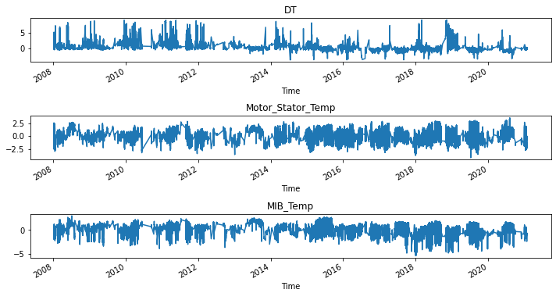
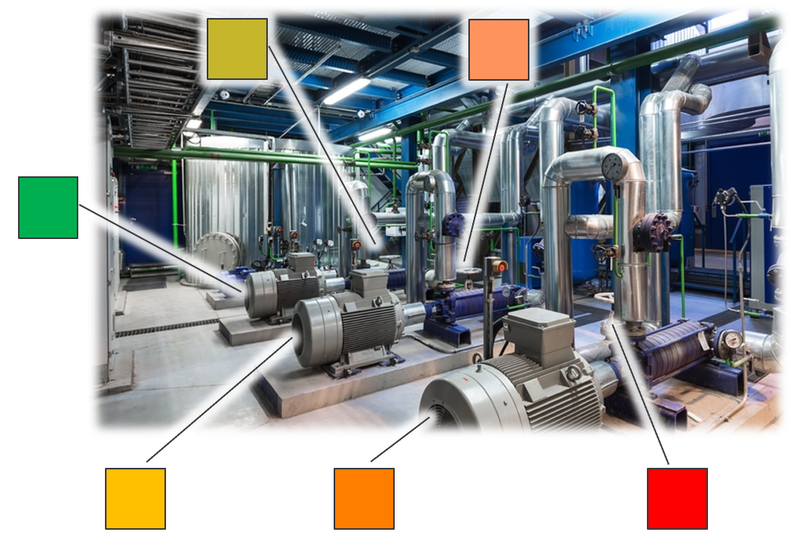
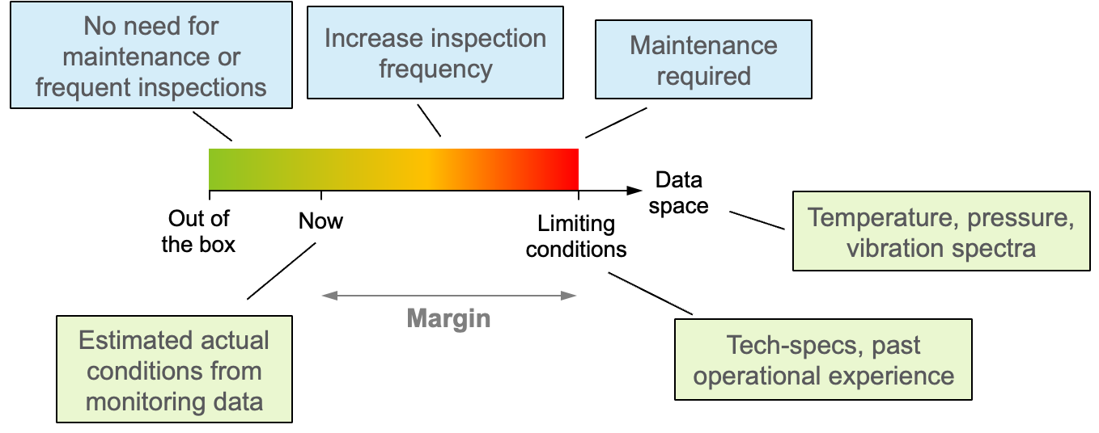
Use Case 1: Assessing Plant Health
Reliability mindset
Assess system health by integrating health information of all its assets
Identify the most critical assets that need attention
State of practice reliability methods have limitations when dealing with condition-based data
The issue resides within the definition of failure rates
Introducing a margin-based reliability approach
Decisions
Data

Slide 6
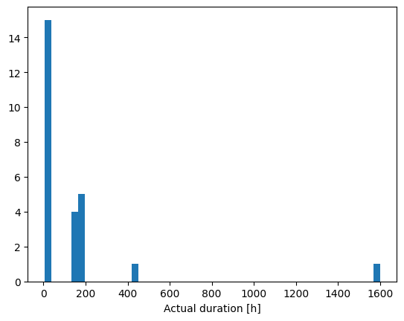
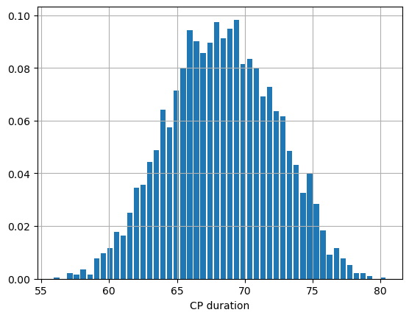
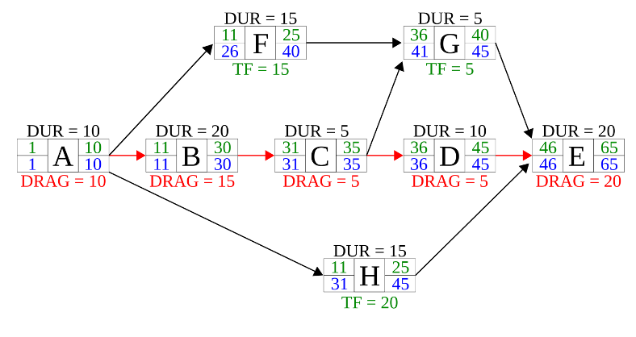
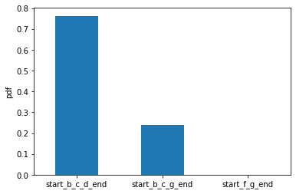
Use Case 2: Plant Outage Analysis
Context: Plant outages are the most critical phases in a plant life
Goal: Evaluate impact of duration uncertainties on plant outage schedule
Workflow
Propagate activity duration variance
Evaluate outage duration and path
Evaluate “risky” paths
Outage duration
variance
Outage path variance

Slide 7
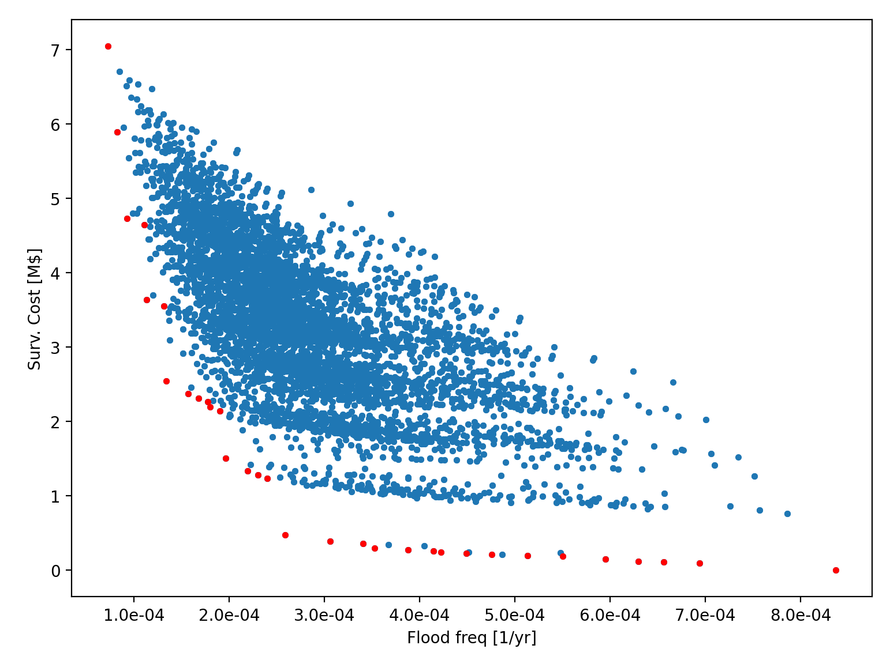
Use Case 3: Plant Risk Optimization
Architecture, material
Type and frequency of surveillance, and maintenance activities
Context: Advanced reactors
Decision space: Choose an optimal design and reliability strategy for a plant system
Objective: Maximization/minimization of plant level figure of merits (O&M costs, reliability)
Degree of freedoms: Surveillance strategies
Types and frequency
Models
System reliability model
Fault-tree based
System cost model
Fixed costs (apparatus and personnel training)
Variable costs (per inspection session)
Analysis steps
Evaluation of all scenarios
Perform multi-objective optimization
Optimal scenarios in the Pareto frontier (red dots)
 | Non-Destructive Evaluation (NDE) | On-line leak detection (OLLD)
Types | Phased_array EddyCurrent + ultrasonic Do_nothing | Visual Imaging_spectra Do_nothing
Frequency | 3,6,9,15 years | 1.5, 3, 4.5, 6 years
NDE and OLLD maximized
Do nothing

Slide 8
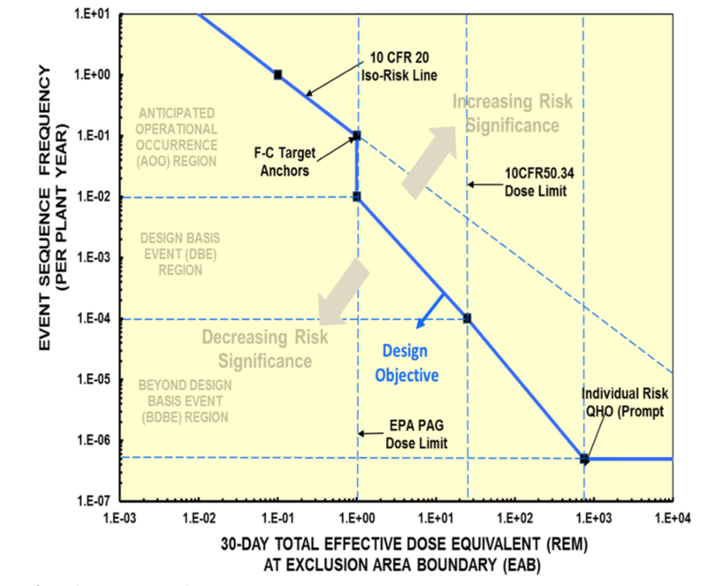
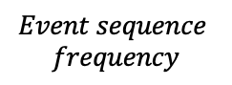
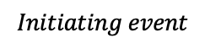
Use Case 3: Plant Risk Optimization
Starting point: Full plant PRA model
Level 2: Event sequence optimization
Single-objective optimization (genetic algorithm)
Model: event sequence PRA model
Decision space: optimal combination of basic events for all systems
Level 1: Locally optimize each system (failure probability vs. costs)
Multi-objective optimization
Output: optimal combinations of basic events
$$Initiating event$$
Sys 3
Sys 6
Plant
Sys 1
Sys 4
Sys 7
Sys 2
Sys 5
$$Event sequence$$
$$frequency$$
seq1
seq2
seq3

Slide 9
Use Case 4: Dynamic Risk Assessment
Simulation-based approach to safety and risk analysis
Coupling RAVEN with desired code (e.g., RELAP5-3D, MAAP, MELCOR)
Modus operandi
Associate probability distributions to specific events/parameters
E.g., AC power recovery
Run the simulator codes multiple times according to the desired sampling strategy
Changing the timing and sequencing of events
Analyze large and complex datasets

Slide 10
Use Case 4: Dynamic Risk Assessment
Test case: 3-loop PWR system and a Large Break LOCA event
Scope of the analysis: Measure differences between Classical and Dynamic PRA analyses
Core damage probability
Dynamic PRA (RAVEN-RELAP5): 8.24 E-3
Classical PRA (SAPHIRE): 8.13 E-3

